Slide 1
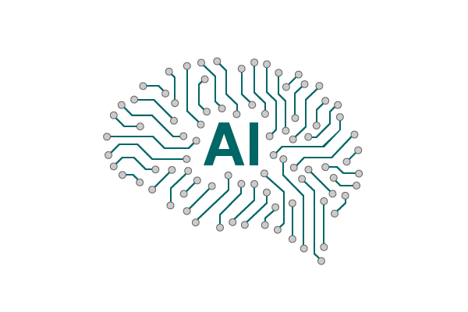
Artificial Intelligence

Slide 2
OBJECTIVES
What is Artificial Intelligence (AI)
Myths about AI
AI and related disciplines

Slide 3
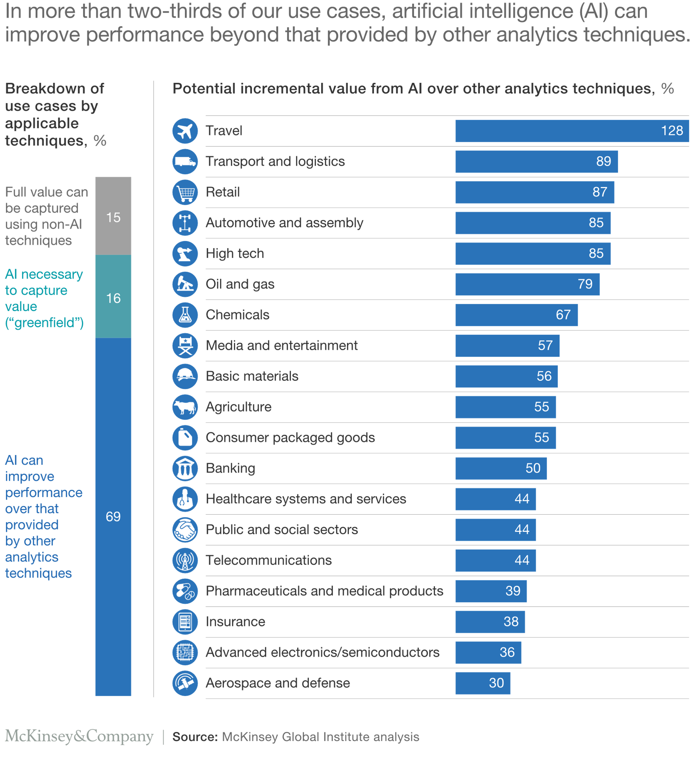
$13 Trillion
AI value creation by 2030
A lot of the value created by AI will be outside the software industry. AI will have a huge impact on all the major industries.

Slide 4
There are two types of AI
ANI
Artificial Narrow Intelligence
ALMOST NO PROGRESS
AGI
Artificial General Intelligence
LOTS OF PROGRESS

Slide 5
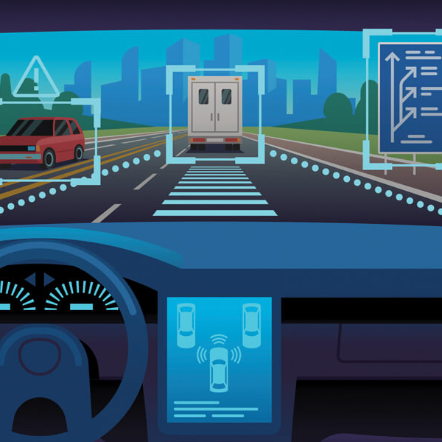
ARTIFICIAL NARROW INTELLIGENCE (ANI)
These are AIs that do one thing such as:
● Smart speaker
● Self-driving car
● Speech recognition
● Automated chatbots
These types of AI are one trick ponies but when you find the appropriate trick, this can be incredibly valuable.

Slide 6

ARTIFICIAL GENERAL INTELLIGENCE (AGI)
They can do anything a human can do or maybe even be super intelligent and do even more things than any human can.

Slide 7
AI and related disciplines
Machine Learning
Data Science
Deep Learning / Neural Network
Machine Learning is a Field of study that gives computers the ability to learn without being explicitly programmed
Deep Learning is a subfield of machine learning concerned with algorithms inspired by the structure and function of the brain called artificial neural networks.
Data science is the science of extracting knowledge and insights from data
The output of a data science project is a set of insights that can help you make business decisions

Slide 8
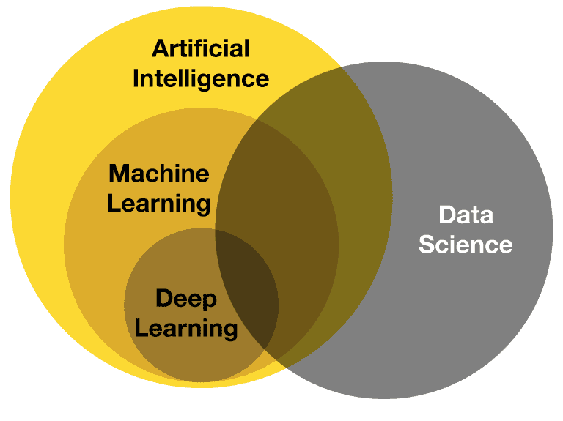
AI and related disciplines

Slide 9
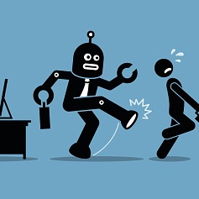
Myths about AI
AI will Supersede Human jobs
AI can process any data
AI will enslave human
AI is only for large business
AI can make independent decisions

Slide 10
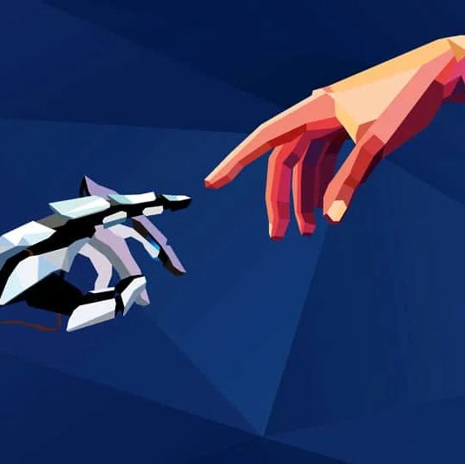
Reality
AI will change existing jobs and create new ones
The quality and quantity of data matters
AI is as smart as you program it
AI is for every industry
AI programs need to be taught first

